Slide 1
AZ-400.00 Learning Path 09: Implement continuous feedback

Slide 2
Learning Path overview

Slide 3
Learning Path overview
Module 01: Implement tools to track usage and flow
Module 04: Design processes to automate application analytics
Module 05: Manage alerts, Blameless retrospectives and a just culture
Module 02: Develop monitor and status dashboards
Module 03: Share knowledge within teams
Labs & Learning Path review and takeaways

Slide 4
Learning objectives
After completing this Learning Path, students will be able to:
Develop monitoring and status dashboards
Implement tools to track system usage, feature usage, and flow
Integrate and configure ticketing systems with development team’s work management
Design processes to automate application analytics
Manage alerts and reduce meaningless and non-actionable alerts
Carry out blameless retrospectives and create a just culture

Slide 5
Module 01: Implement tools to track usage and flow

Slide 6
Understand the inner loop
The inner loop
Code
Build
Test

Slide 7

Introduction to continuous monitoring
MIGRATE
GOVERN
Policy management
Cost management
SECURE
Security management
Threat protection
CONFIGURE
Configuration
Update management
Automation
Scripting
PROTECT
Backup
Disaster recovery
MONITOR
App, infra & network monitoring Log Analytics & Diagnostics

Slide 8
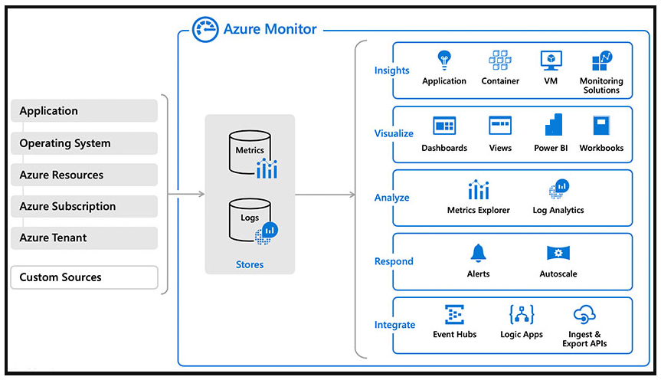
Explore Azure Monitor and Log Analytics
Notes:
Explain about Azure Monitor and suggest to follow the exercise https://docs.microsoft.com/en-us/learn/modules/implement-tools-track-usage-flow/4-explore-azure-monitor-log-analytics or present as Demo.
When you run at cloud scale, you need intelligent logging and monitoring tools that scale to your needs and provide insight into your data in real time.
Azure Monitor is Microsoft's native cloud monitoring solution. Azure Monitor collects monitoring telemetry from different kinds of on-premises and Azure sources.
Azure Monitor provides Management tools, such as those in Azure Security Center and Azure Automation, enabling ingestion of custom log data to Azure.
The service aggregates and stores this telemetry in a log data store optimized for cost and performance.
With Azure Monitor, you can analyze data, set up alerts, get end-to-end views of your applications. And use machine-learning-driven insights to identify and resolve problems quickly.

Slide 9
Examine Kusto Query Language (KQL)
KQL is the language used to query Log Analytics
Supports queries and control commands
Supported within Azure Data Explorer and Azure Data Studio (with notebook support)

Slide 10

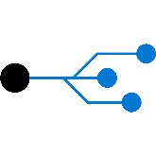
Explore Application Insights
Web pages
Client apps
Alerts
AI
Power BI
Https request
Application Insights
Your Web Services
Visual
Studio
AI
Dependency Calls
REST API
SQL
External Services
Background Services
Continuous
Export
AI
Azure

Slide 11
Implement Application Insights
Monitor
Detect, diagnose
Build, measure, learn

Slide 12
Demonstration: Add Application Insights to an ASP.NET core application
DEMO
Notes:
Take a moment to complete the demonstration, as defined in the student manual.

Slide 13
Module 02: Develop monitor and status dashboards

Slide 14
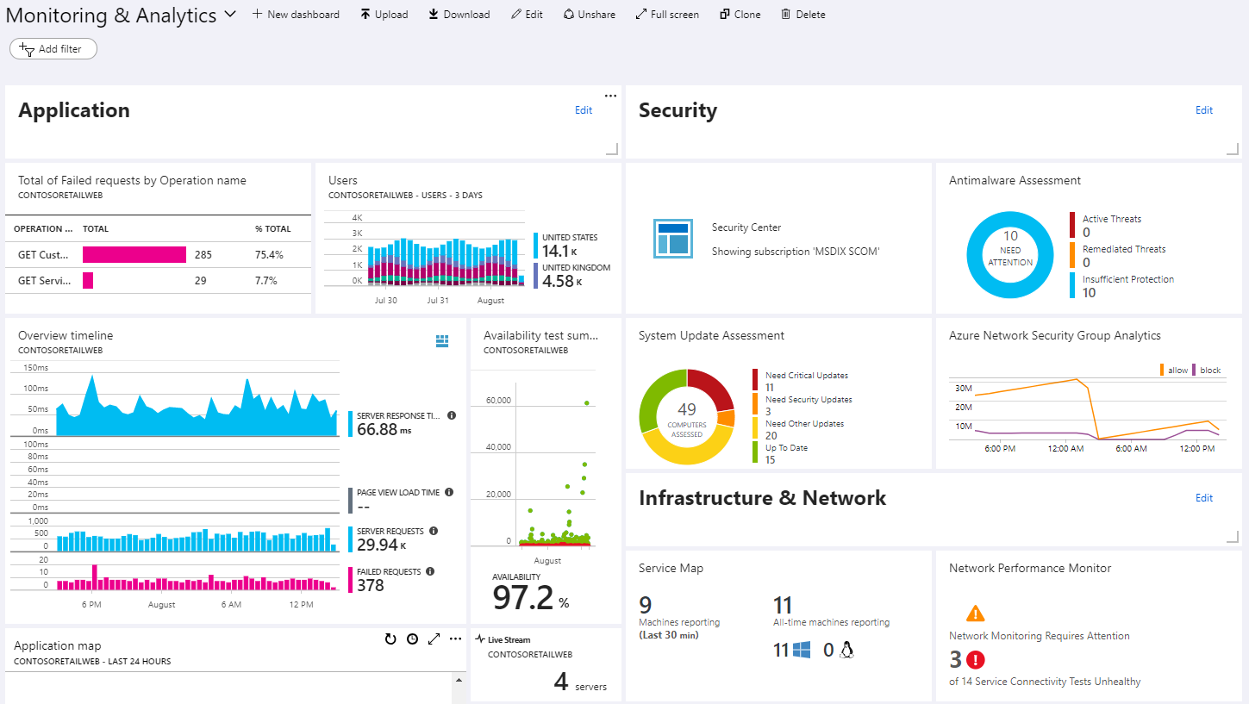
Explore Azure Dashboards

Slide 15
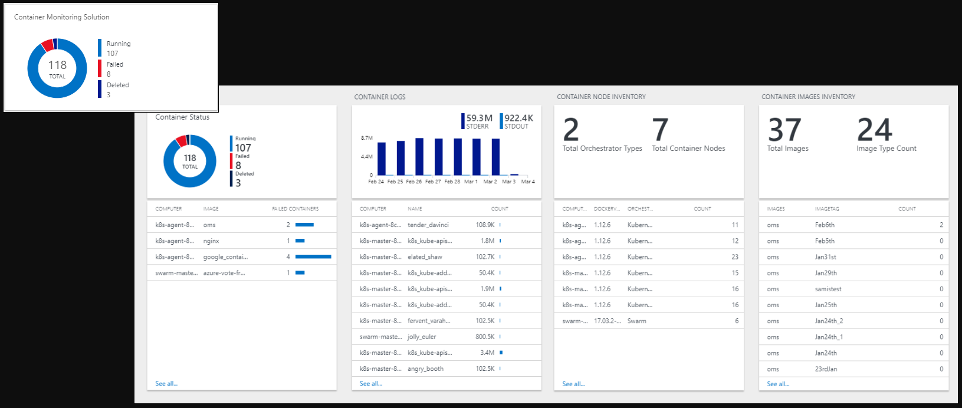
Examine view designer in Azure Monitor

Slide 16
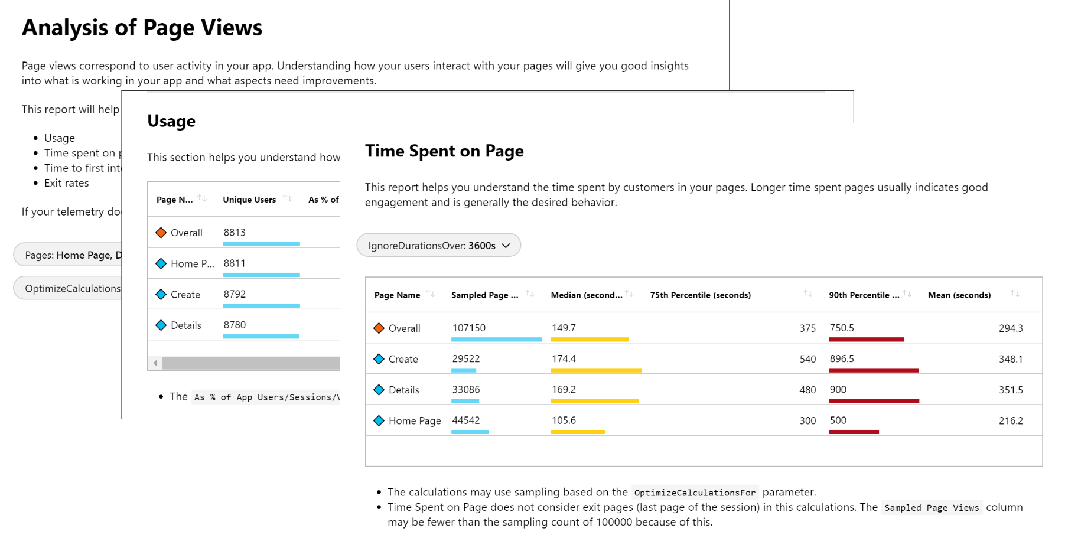
Explore Azure Monitor workbooks

Slide 17
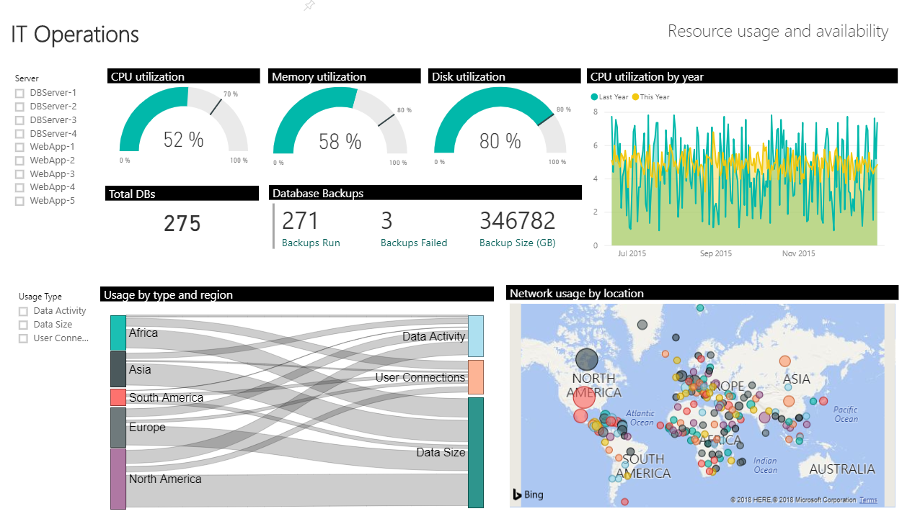
Explore Power BI

Slide 18
Build your own custom application
Advantages:
Complete flexibility
Combine metrics and log data
Disadvantages:
Significant engineering required

Slide 19
Module 03: Share knowledge within teams

Slide 20
Share acquired knowledge within development teams
Organizational knowledge is acquired over time
Organizational knowledge can easily be lost through staff turnover
Relearning old lessons is wasteful and expensive
Notes:
See http://owasp.org

Slide 21
Discussion: Tools for knowledge sharing
Which knowledge sharing tools do you currently use?
What do you or don’t you like about the tools?

Slide 22
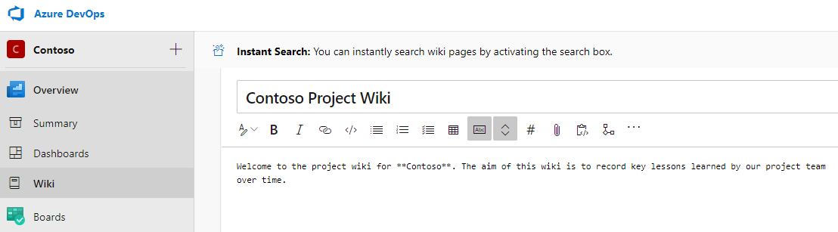
Introduction to Azure DevOps project wikis
Created in Azure DevOps projects, stored in a repository

Slide 23
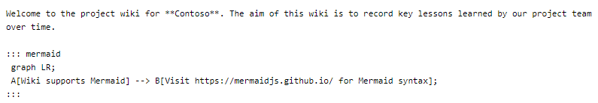
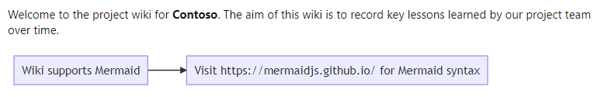
Wiki contents
Written in markdown and can contain file attachments, including videos
Supports insertion of Mermaid diagrams

Slide 24
Module 04: Design processes to automate application analytics

Slide 25
Explore rapid responses and augmented search
1
In Agile teams, issues that "slip through the cracks" directly impact end-users
2
Speedy resolution required – even if root cause determined later
3
Large volume of infrastructure and application logs to search
4
Augmented search uses semantic processing, statistical models, and ML

Slide 26
Integrate telemetry
Benefits:
Provides detailed accurate insights on usage
Monitors an object while physically far removed from it
Challenges:
Do end users want it enabled?
Users might not be comfortable with being monitored

Slide 27
Examine monitoring tools and technologies
Synthetic monitoring
Alert management
Deployment automation
Analytics

Slide 28
Explore IT Service Management Connector
Advantages:
Create an incident or alert in your service desk solution based on alerts from Azure
Sync incident data from service desk solution to Azure Log Analytics
Correlate service desk data with Log Analytics data

Slide 29
Module 05: Manage alerts, Blameless retrospectives and a just culture

Slide 30
Examine when to get notifications
Application Insights automatically analyzes the performance of your web application and can warn you about potential problems

Slide 31
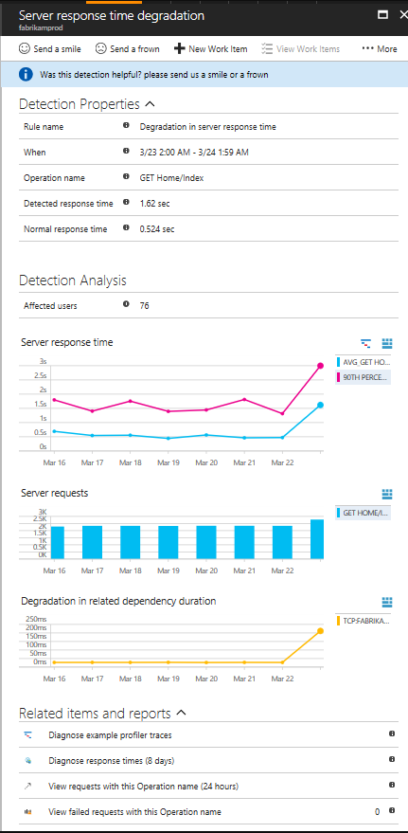
Explore how to fix it
Triage (how many users/ops are affected?)
Scope (all traffic or some pages?)
Diagnose (often will suggest the issue)

Slide 32
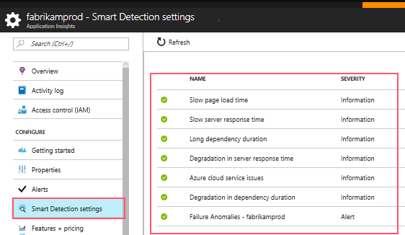
Explore smart detection notifications

Slide 33
Improve performance
1
Triage
2
Diagnose slow page loads
3
Improve slow pages

Slide 34
Example: Understand server response time degradation
Response time compared to normal response time
Number of affected users
Average response time
Count of this operation requests on the day of detection and 7 days before
Correlation between degradation in this operation and degradations in related dependencies
Links to help diagnose the problem

Slide 35
Reduce meaningless and non-actionable alerts
Monitoring and alerting enables a system to tell us when it’s broken, or, potentially, what’s about to break
Alerts requesting immediate action should be urgent, important, actionable, and real

Slide 36
Discussion: Blameless retrospective
What does it mean to have a blameless retrospective?

Slide 37
Labs

Slide 38
Lab: Monitoring application performance with Application Insights
Lab overview:
In this lab, you'll learn about how you can add Application Insights to an existing web application, as well as how to monitor the application via the Azure portal.
Objectives:
Deploy Azure App Service web apps
Generate and monitor Azure web app application traffic by using Application Insights
Investigate Azure web app performance by using Application Insights
Track Azure web app usage by using Application Insights
Create Azure web app alerts by using Application Insights
Duration:
Notes:
The labs are updated on a regular basis. For the latest information please visit:
https://microsoftlearning.github.io/AZ400-DesigningandImplementingMicrosoftDevOpsSolutions/

Slide 39
Lab: Integration between Azure DevOps and Microsoft Teams
Lab overview:
In this lab, you will implement integration scenarios between Azure DevOps services and Microsoft Teams.
Objectives:
Integrate Microsoft Teams with Azure DevOps
Integrate Azure DevOps Kanban boards and Dashboards in Teams
Integrate Azure Pipelines with Microsoft Teams
Install the Azure Pipelines app in Microsoft Teams
Subscribe for Azure Pipelines notifications
Duration:
Notes:
The labs are updated on a regular basis. For the latest information please visit:
https://microsoftlearning.github.io/AZ400-DesigningandImplementingMicrosoftDevOpsSolutions/

Slide 40
Lab: Sharing team knowledge using Azure project wikis
Lab overview:
In this lab, you will create and configure wiki in an Azure DevOps, including managing markdown content and creating a Mermaid diagram.
Objectives:
Create a wiki in an Azure Project
Add and edit markdown
Create a Mermaid diagram
Duration:
Notes:
The labs are updated on a regular basis. For the latest information please visit:
https://microsoftlearning.github.io/AZ400-DesigningandImplementingMicrosoftDevOpsSolutions/

Slide 41
Learning Path review and takeaways

Slide 42
What did you learn?
Develop monitoring and status dashboards
Implement tools to track system usage, feature usage, and flow
Integrate and configure ticketing systems with development team’s work management
Design processes to automate application analytics
Manage alerts and reduce meaningless and non-actionable alerts
Carry out blameless retrospectives and create a just culture

Slide 43
Learning Path review questions
Does Azure Monitor allow you to create alerts from log queries?
1
What features are provided by Azure Monitor?
2
3
What query language can you use to query Azure Log Analytics?
4
What platform integrations does Azure Monitor provide to visualize your logs in real time?
5
True or False: Application Insights analyses the traffic from your website against historic trends and sends you smart detection notifications on degradation.
Notes:
Q1 Answer: yes
Q2 Answer: 1. Detect and diagnose issues across applications and dependencies with Application Insights.
2. Correlate infrastructure issues with Azure Monitor for VMs and Azure Monitor for Containers.
3. Create visualizations with Azure dashboards and workbooks.
4. Support operations at scale with smart alerts and automated actions.
Q3 Answer: Kusto Query Language (KQL)
Q4 Answer: Power BI
Q5 Answer: True

